Slide 1
2MD-2
Grouping problems: missing factors and division

Slide 2
2MD-2 Relate grouping problems where the number of groups is unknown to multiplication equations with a missing factor, and to division equations (quotitive division).
The materials in this pack have been collated and written to support the teaching of 2MD-2. Before planning and teaching the content, read the teaching guidance and example assessment questions in the non-statutory guidance itself, which can be found here.
A video summarising all of the ready-to-progress criteria for Year 2 can be found here.

Slide 3
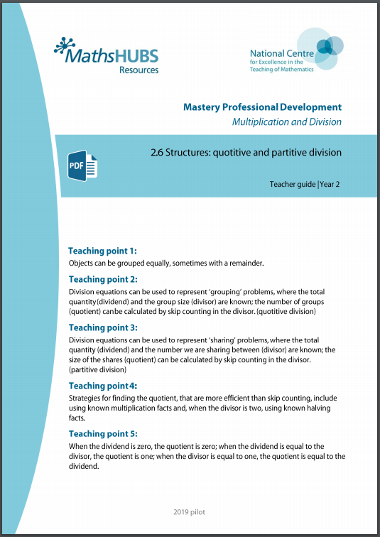
2MD-2: Linked mastery PD materials
Additional pedagogical subject knowledge support can be found in the Mastery Professional Development Materials:
2.6 Structures: quotitive and partitive division
Several of the activity slides have been taken from these materials.

Slide 4
2MD-2 Linked video lessons
Key Stage 1 multiplication 3
Finding missing factors and products, using knowledge of the two times table
Varied practice applying knowledge of the two times table

Slide 5
2MD-2
Grouping problems: missing factors and division

Slide 6
The following slides contain activities that can be used within the context of pre-teaching, intervention, or as supplementary material integrated into teaching. They do not represent complete lessons and should not be used as such. Also they should not be used all at once, but over the period of a teaching unit. It would be valuable to use many of the activities more than once to build fluency in understanding and application. Also many of them would benefit from the use of manipulatives to support interaction with the ideas. Ensure you engage in rich discussion with the children, asking them to reason and explain the ideas presented. Note that when working with a small group, pupils should also have access to the main teaching delivered by the class teacher and the focus should be directly linked so that the learning is connected and fluency is built.

Slide 7
Guidance for working with a small pre-teaching or intervention group
Take time to build understanding of the key idea. We would recommend no more than four slides in any one session, and probably fewer.
In subsequent sessions, review and practise previous learning before moving on.
Play the animation/observe the image and ask pupils “What do you notice?”.
Encourage pupils to explain what they see, what is happening and why.
Where there is a highlighted sentence, draw out the meaning of this from the image and repeat together and individually.

Slide 8
Guidance for working with a small pre-teaching or intervention group
Engage in the suggested activities, using manipulatives where appropriate, to enhance the interaction and stimulate discussion. However, note that the ultimate aim is to develop fluency in the mathematical ideas such that resources are no longer needed.
Repeat questions, using other numbers/examples where relevant.
Repeat the highlighted language structures wherever relevant to build fluency with the key idea and connect the learning. For example:
10 hundreds are equivalent to 1,000.

Slide 9
2MD-2 Grouping problems: missing factors and division

Slide 10
2MD-2 Grouping problems: missing factors and division
3
× 5 = 15
How many bags of biscuits do you think I can make if I put 5 biscuits in each bag?
In the missing number calculation, what does the 5 represent? What do you think the 15 represents?
So the missing factor represents the…?
Do you need to skip count in 5s to 15 to find the missing factor, or can you use a multiplication fact you already know to help you?
So, we made 3 bags, each with 5 biscuits. So the missing factor is…

Slide 11
2MD-2 Grouping problems: missing factors and division
15 ÷ 5 =
3
Let’s think about the same number story using division.
Can you complete the sentence about the biscuits? ___ divided into groups of ___
Can you read the division expression using these words? ___ divided by ___
Can you use skip counting or a multiplication fact to find the answer? What does each number represent?
15
5
15
5
The 15 represents the number of biscuits.
The 5 represents the number of biscuits in each bag.
The 3 represents the number of bags.

Slide 12
2MD-2 Grouping problems: missing factors and division
7
× 2 = 14
How many flower pots do you think I will need if I plant 2 seeds in each pot? Will I need some more?
In the missing number calculation, what do the 2 and the 14 represent? What does the missing factor represent?
Can you use skip counting in 2s or your multiplication facts to find the missing factor?
So, I will need _____ pots if I have 14 seeds altogether and I put 2 in each pot.
7

Slide 13
2MD-2 Grouping problems: missing factors and division
14 ÷ 2 =
7
Let’s represent this number story with division. What do the 14 and the 2 represent?
Can you complete the sentence about the seeds? ___ divided into groups of ___
Can you read the division expression using these words? ___ divided by ___
Can you use skip counting or your multiplication facts to find the answer? What does the 7 represent?
14
2
14
2
The 14 represents the number of seeds.
The 2 represents the number of seeds in each pot.
The 7 represents the number of pots.

Slide 14
2MD-2 Grouping problems: missing factors and division
I have 6 seeds. How many pots will I need to put 2 seeds in each pot?
Collect 6 counters or cubes to represent seeds and some cups to represent pots.
Can you divide 6 cubes into groups of 2? How many pots will you need?
Can you write the division calculation to represent 6 divided by 2?
What times table fact could help you find the answer?
If you use skip counting, what multiples will you need to count in?

Slide 15
2MD-2 Grouping problems: missing factors and division
60cm
6
× 10 = 60
10cm
10cm
10cm
10cm
10cm
10cm
How many 10cm pieces do you think I can cut from the ribbon?
What do the 10 and the 60 represent in the missing number calculation?
What does the missing factor represent?
What multiples do you think we should skip count in, or which times table fact should we use, to find the answer?
So, if I have 60cm of ribbon, I can cut _____ pieces which are each 10cm long from it.
6

Slide 16
2MD-2 Grouping problems: missing factors and division
60cm
60 ÷ 10 =
6
10cm
10cm
10cm
10cm
10cm
10cm
Let’s represent the same story with division. Can you read the calculation using the words divided by?
What does each number in the division calculation represent?
Can you remember the times table fact which helps us answer 60 divided by 10?
So, if I have 60cm of ribbon, I can cut _____ pieces of 10cm ribbon.
6

Slide 17
2MD-2 Grouping problems: missing factors and division
80cm
Get a piece of string or ribbon and cut off 80cm. Use your metre ruler!
Can you predict how many pieces which are each 10cm long you can make from your string or ribbon?
Write down the division calculation you need and say what each number means. Read it using the words divided by.
Can you calculate the answer by skip counting or using a times table fact?
Now test out your answer by cutting your string or ribbon into 10cm pieces. Be as accurate as possible!

Slide 18
2MD-2 Grouping problems: missing factors and division
2MD-2 Grouping problems: missing factors and division
45 ÷ 5 =
9
Read the division using the words divided by.
If we use skip counting, what multiple should we count in?
Can you say and write the times table fact which helps us with 45 divided by 5?
5
5
5
5
5
5
5
5
5

Slide 19
2MD-2 Grouping problems: missing factors and division
12 ÷ 2 =
6
Read the division using the words divided by.
If we use skip counting, what multiple should we count in?
Can you say and write the times table fact which helps us with 12 divided by 2?
2
2
2
2
2
2

Slide 20
2MD-2 Grouping problems: missing factors and division
40 ÷ 10 =
4
Read the division using the words divided by.
If we use skip counting, what multiple should we count in?
Can you say and write the times table fact which helps us with 40 divided by 10?
10
10
10
10

Slide 21
2MD-2 Grouping problems: missing factors and division
10
2
20 ÷ 10 =
20 ÷ 5 =
20 ÷ 2 =
2
2
50 ÷ 10 =
25 ÷ 5 =
10 ÷ 2 =
5
5
10
Make some 10s, 5s and 2s tokens or use coins.
Decide which tokens you need to use to help represent each pair of calculations.
Can you put out the correct number of tokens to match each calculation?
Can you write a times table fact which helps with each calculation?

Slide 22
2MD-2 Grouping problems: missing factors and division
8 ÷ 2 =
15 ÷ 5 =
8 ÷ 2 =
Read the division calculations using the words divided by.
Can you make up your own stories to match these calculations?
You could use counters or cubes to represent biscuits, seeds, coins or anything you can put into groups!
Represent your story with objects or a picture and tell it to someone. Can they say which division calculation matches your story?
Now write the multiplication fact which helps you.

