Slide 1
2MD-1
Multiplication as repeated addition

Slide 2
2MD-1 Recognise repeated addition contexts, representing them with multiplication equations and calculating the product, within the 2, 5 and 10 multiplication tables.
The materials in this pack have been collated and written to support the teaching of 2MD-1. Before planning and teaching the content, read the teaching guidance and example assessment questions in the non-statutory guidance itself, which can be found here.
A video summarising all of the ready-to-progress criteria for Year 2 can be found here.

Slide 3
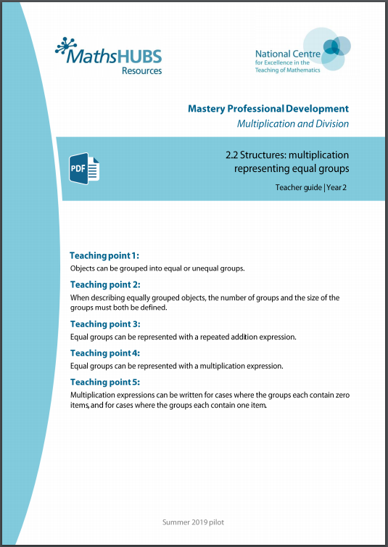
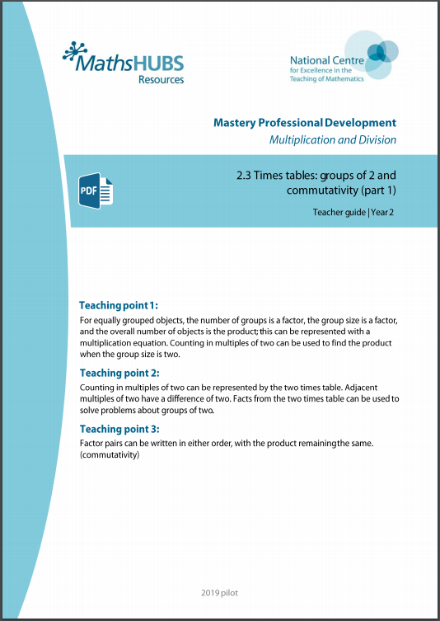
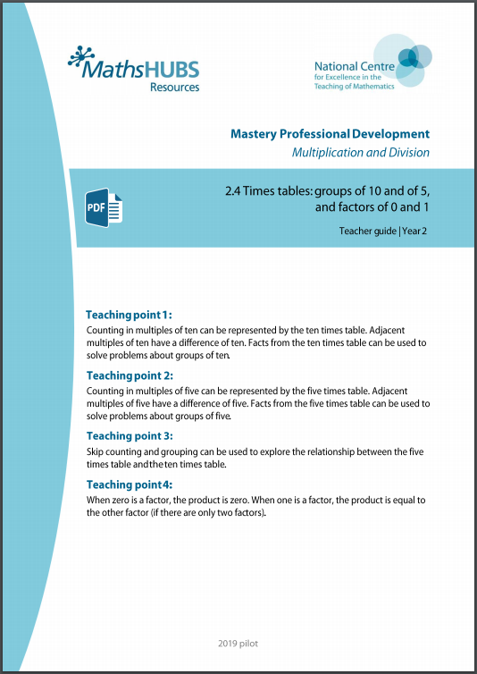
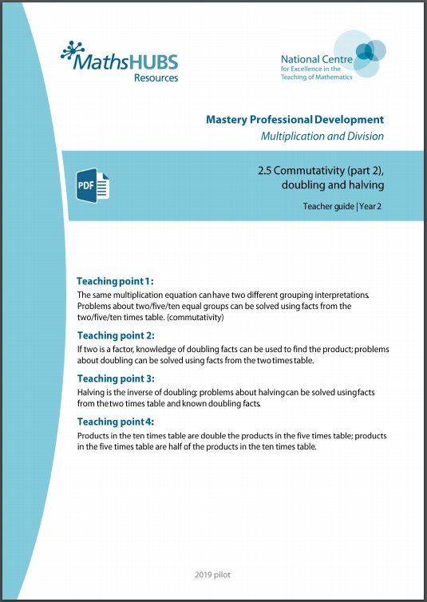
2MD-1: Linked mastery PD materials
Additional pedagogical subject knowledge support can be found in the following Mastery Professional Development materials:
2.2 Structures: multiplication representing equal groups
2.3 Times tables: groups of 2 and commutativity (part 1)
2.4 Times tables: groups of 10 and of 5, and factors of 0 and 1
2.5 Commutativity (part 2), doubling and halving
Several of the activity slides have been taken from these materials.

Slide 4
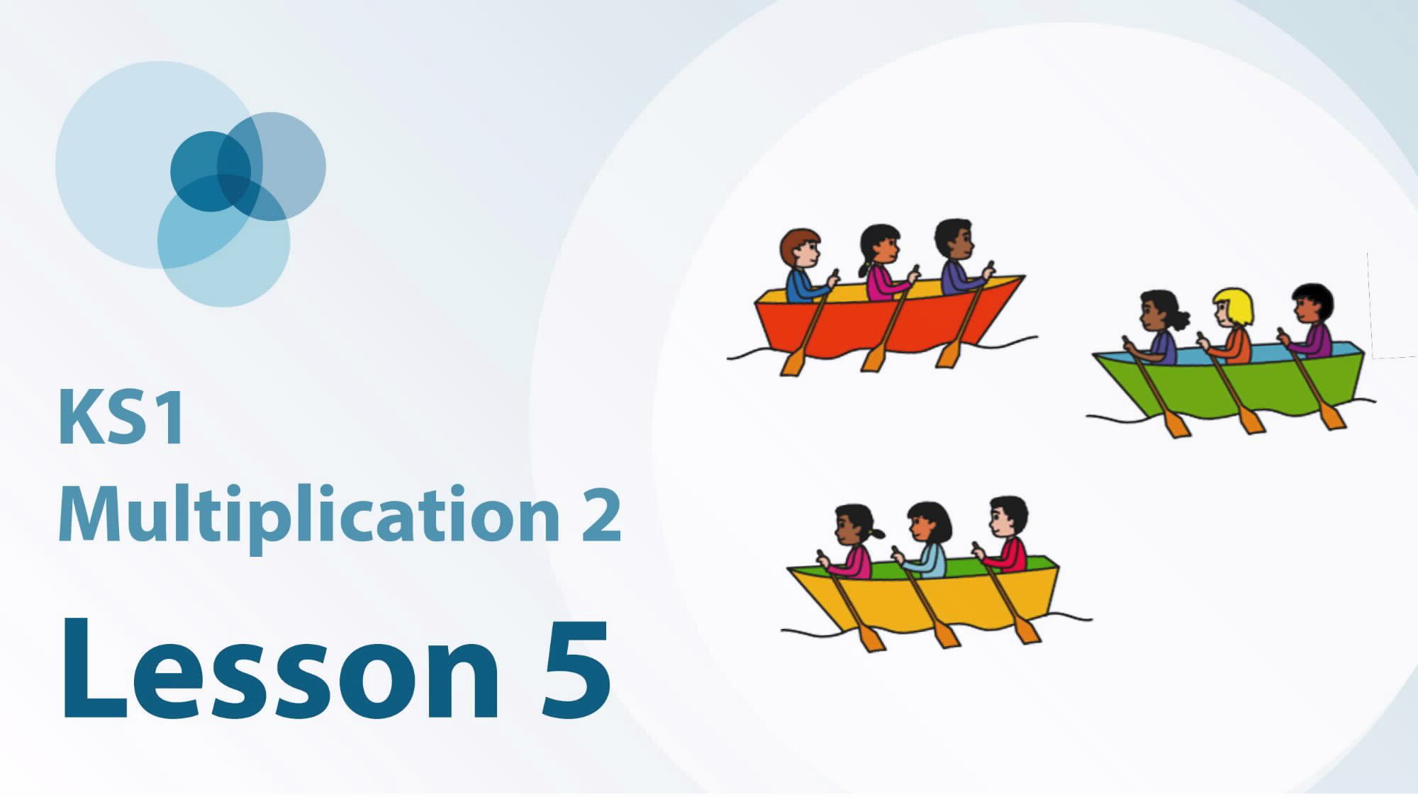
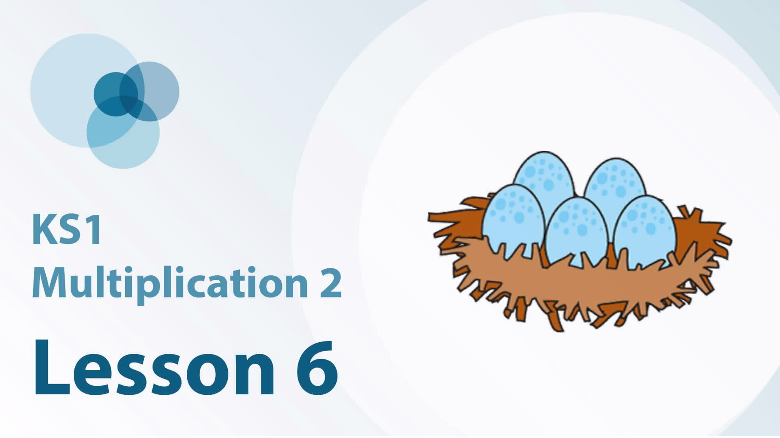
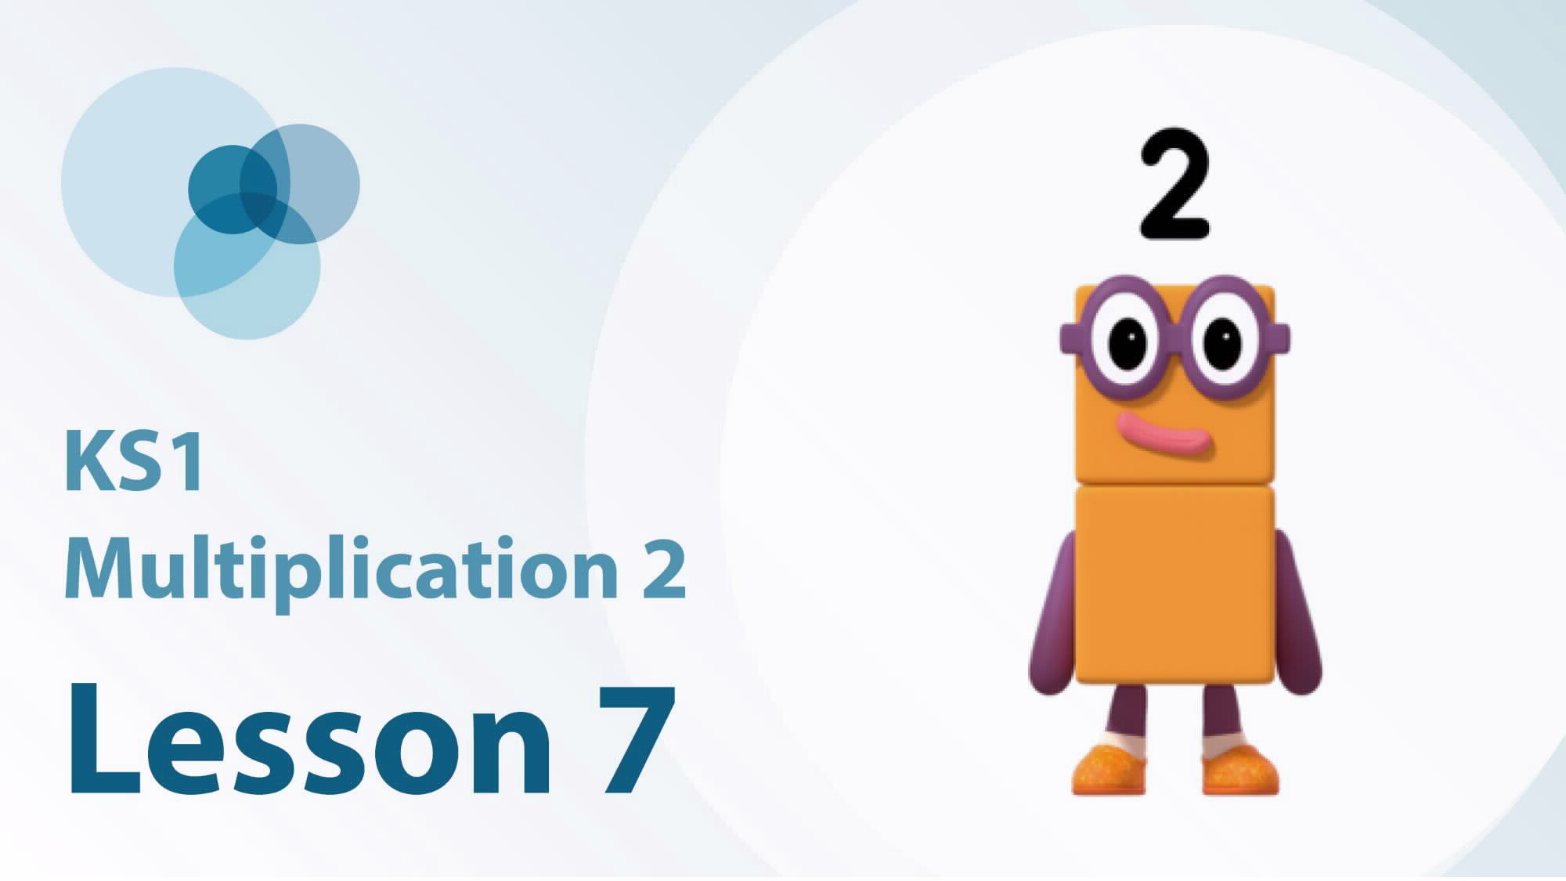
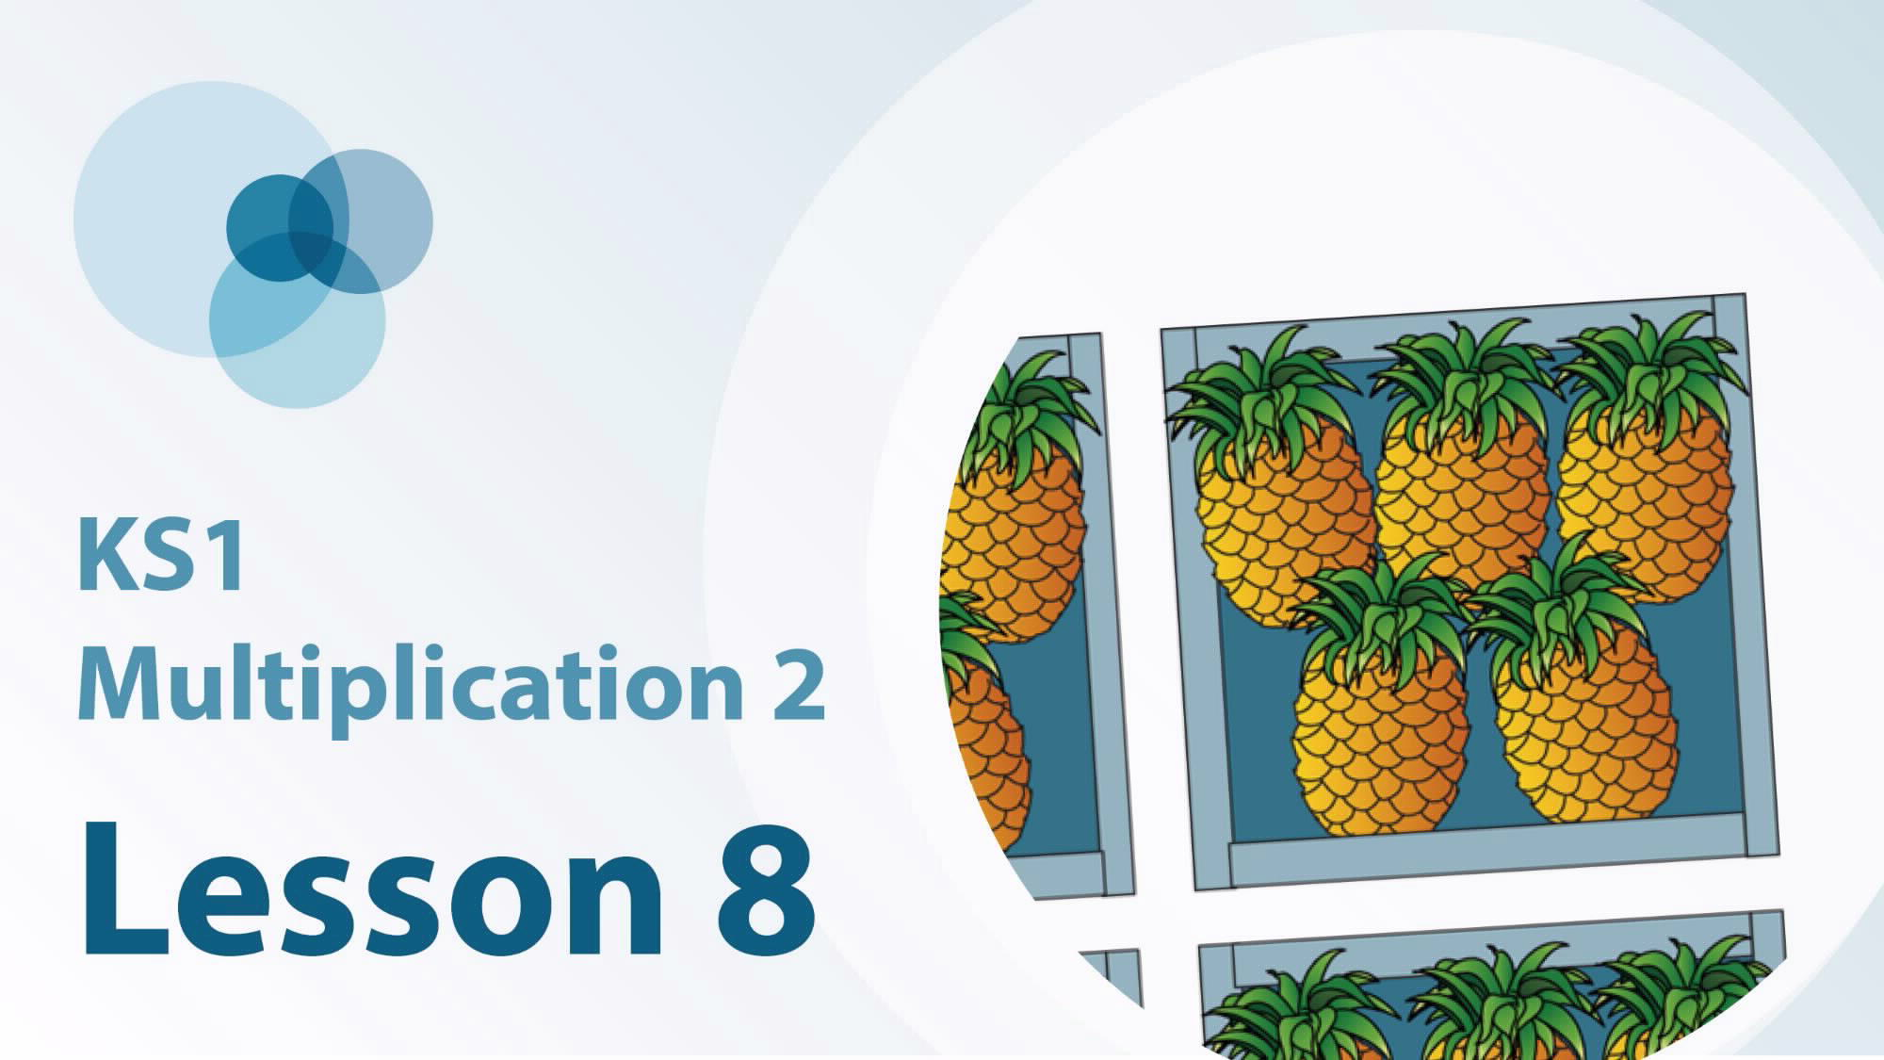
2MD-1 Linked video lessons
Key Stage 1 multiplication 2

Slide 5
2MD-1 Linked video lessons
Key Stage 1 multiplication 3

Slide 6
2MD-1
Multiplication as repeated addition

Slide 7
The following slides contain activities that can be used within the context of pre-teaching, intervention, or as supplementary material integrated into teaching. They do not represent complete lessons and should not be used as such. Also they should not be used all at once, but over the period of a teaching unit. It would be valuable to use many of the activities more than once to build fluency in understanding and application. Also many of them would benefit from the use of manipulatives to support interaction with the ideas. Ensure you engage in rich discussion with the children, asking them to reason and explain the ideas presented. Note that when working with a small group, pupils should also have access to the main teaching delivered by the class teacher and the focus should be directly linked so that the learning is connected and fluency is built.

Slide 8
Guidance for working with a small pre-teaching or intervention group
Take time to build understanding of the key idea. We would recommend no more than four slides in any one session, and probably fewer.
In subsequent sessions, review and practise previous learning before moving on.
Play the animation/observe the image and ask pupils “What do you notice?”.
Encourage pupils to explain what they see, what is happening and why.
Where there is a highlighted sentence, draw out the meaning of this from the image and repeat together and individually.

Slide 9
Guidance for working with a small pre-teaching or intervention group
Engage in the suggested activities, using manipulatives where appropriate, to enhance the interaction and stimulate discussion. However, note that the ultimate aim is to develop fluency in the mathematical ideas such that resources are no longer needed.
Repeat questions, using other numbers/examples where relevant.
Repeat the highlighted language structures wherever relevant to build fluency with the key idea and connect the learning. For example:
10 hundreds are equivalent to 1,000.

Slide 10
2MD-1 Multiplication as repeated addition

Slide 11
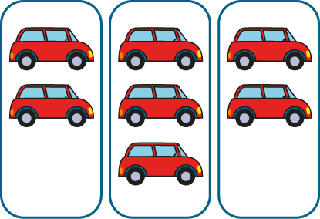
2MD-1 Multiplication as repeated addition
Watch the pictures and see if you can spot some equal groups. Can you explain what we mean by an equal group? Which groups are equal and which groups are not equal?
Can you say how many items there are in each of the equal groups?
Can you say how many groups there are?
Equal groups have the same number of objects in each group.

Slide 12
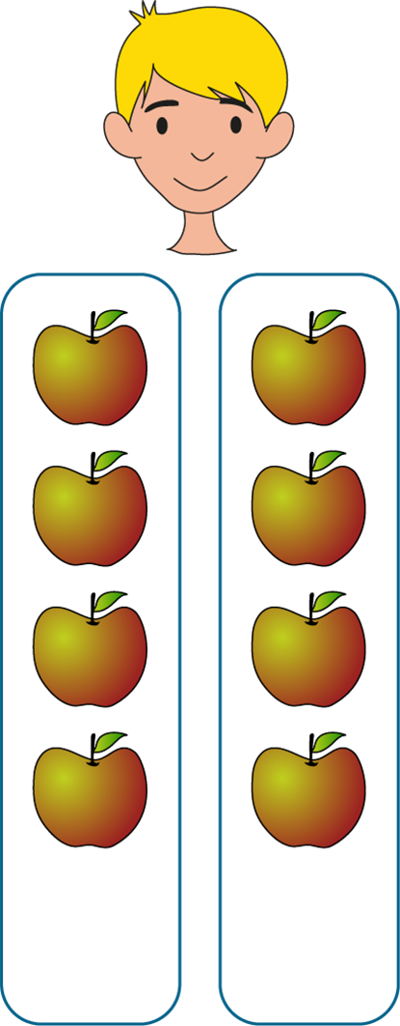
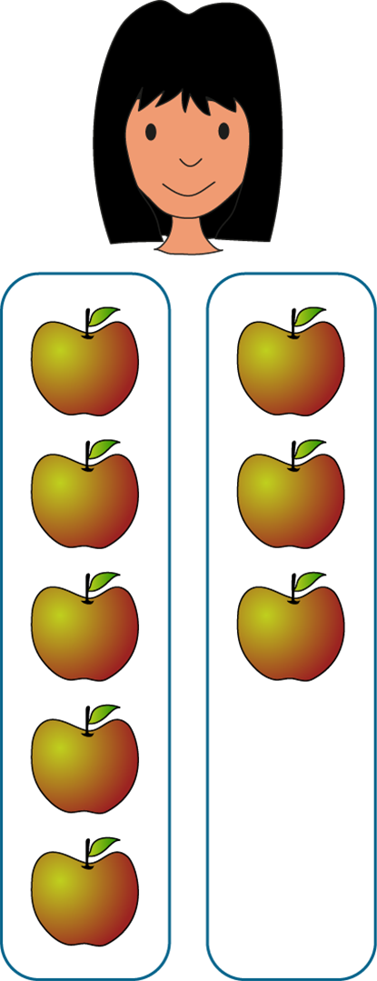
2MD-1 Multiplication as repeated addition
Max
Lucia
Have Max and Lucia put their apples into equal groups?
How many apples are in each of Max’s groups?
Collect 6 cubes and see if you can put them into equal groups. Say these sentences about your cubes:
There are ____ groups of cubes.
There are ____ cubes in each group.
There are ___ groups of ___.

Slide 13
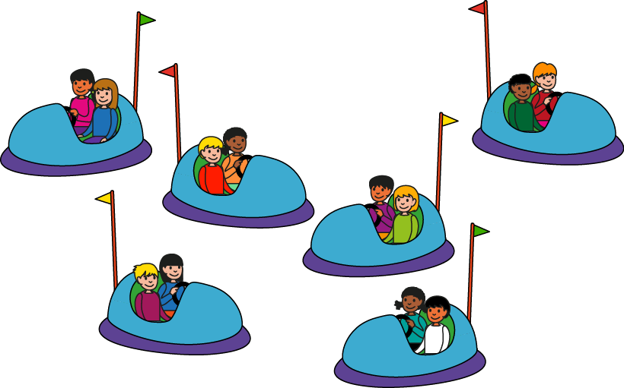
2MD-1 Multiplication as repeated addition
What do you notice about the number of children in each of the cars?
Does each car have the same number of children? So does the picture show equal or unequal groups?
Look at the number of cars (groups).
Can you choose which sentence correctly describes the picture?
There are 2 groups of 6.
There are 6 groups of 2.

Slide 14
2MD-1 Multiplication as repeated addition
Look at the picture. Can you complete the sentence to describe the picture?
There are ___ groups of ___.
3
5
How could we represent this using an addition expression?
What do the 5s mean? Why are there three 5s?
5 + 5 + 5
We can represent equal groups using repeated addition.

Slide 15
2MD-1 Multiplication as repeated addition
How could we represent the equal groups using a multiplication expression?
What does the 3 mean? What does the 5 mean?
Read the final equation. Do you agree that 5 plus 5 plus 5 is equal to 3 times 5? Why?
5 + 5 + 5
3 × 5
5 + 5 + 5 = 3 × 5
We can represent repeated addition using multiplication.

Slide 16
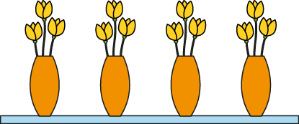
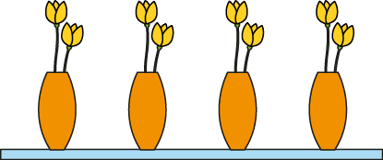
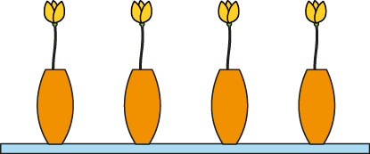
2MD-1 Multiplication as repeated addition
Look at the picture. What do you notice is the same about the pictures? What’s different?
Look at the multiplication expressions. What’s the same about them? What’s different?
Can you match each picture to the correct expression and explain what the numbers mean?
Can you explain what the zero means in 4 x 0?
Using cubes and plates, can you make your own equal groups and write an expression to match?
4 × 1
4 × 3
4 × 0
4 ×2

Slide 17
2MD-1 Multiplication as repeated addition
There are 2 groups of 5.
Which expressions match this statement?
Can you draw a picture of this?
Can you draw pictures to match the other expressions?
2 + 5
5 + 2
5 + 5
2 + 2 + 2 + 2 + 2
2 × 5

Slide 18
2MD-1 Multiplication as repeated addition
Look at the picture and expression.
How can we find out the total number of eggs without needing to count in ones?
If we skip count in multiples of five, how many fives would we need to count?
So, 5, 10, 15… there are ____ eggs in total.
So, 3 times 5 is equal to…?
15
3 × 5 = 15
The 3 represents the number of groups.
The 5 represents the number of eggs in each group.
The 15 represents the total number of eggs.

Slide 19
2MD-1 Multiplication as repeated addition
Can you say what the expression to match the picture should be?
What multiple do we need to skip count in to find out how many pencils there are altogether?
If we skip count in multiples of 10, how many 10s will we need to count?
So, 10, 20, 30, 40, 50, 60, 70, 80, 90… there are ____ pencils altogether.
90
9 × 10 = 90
The 9 represents the number of groups.
The 10 represents the number of pencils in each group.
The 90 represents the total number of pencils.

Slide 20
2MD-1 Multiplication as repeated addition
What expression can we write to match the picture?
Can you tell me what multiple we need to skip count in to find out how many wheels there are altogether on the bikes?
How many twos will you need to count?
So, 7 times 2 is equal to ____.
Can you say what each number in the equation means?
7 × 2 = 14

Slide 21
2MD-1 Multiplication as repeated addition
Catrina’s Cards
https://nrich.maths.org/203

