Slide 1
2AS-3
Add and subtract within 100 – part 1

Slide 2
2AS-3 Add and subtract within 100 by applying related one-digit addition and subtraction facts: add and subtract only ones or only tens to/from a two-digit number.
The materials in this pack have been collated and written to support the teaching of 2AS-3. Before planning and teaching the content, read the teaching guidance and example assessment questions in the non-statutory guidance itself, which can be found here.
A video summarising all of the ready-to-progress criteria for Year 2 can be found here.

Slide 3
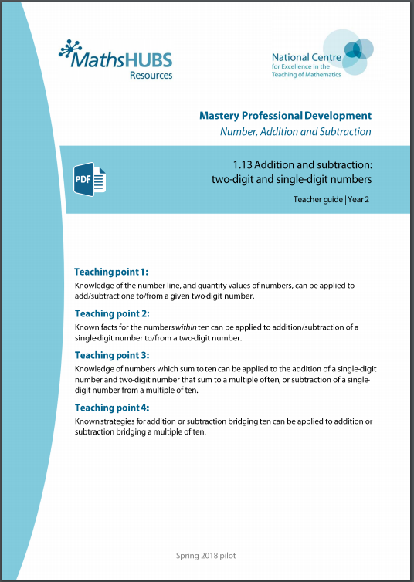
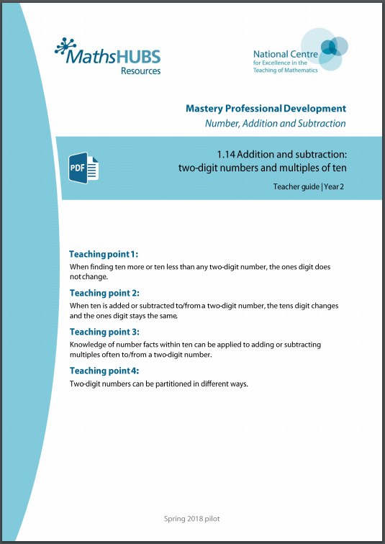
2AS-3: Linked mastery PD materials
Additional pedagogical subject knowledge support can be found in the following Mastery Professional Development materials:
1.13 Addition and subtraction: two-digit and single-digit numbers
1.14 Addition and subtraction: two-digit numbers and multiples of ten
Several of the activity slides have been taken from these materials.

Slide 4
2AS-3
Add and subtract within 100 – part 1

Slide 5
The following slides contain activities that can be used within the context of pre-teaching, intervention, or as supplementary material integrated into teaching. They do not represent complete lessons and should not be used as such. Also they should not be used all at once, but over the period of a teaching unit. It would be valuable to use many of the activities more than once to build fluency in understanding and application. Also many of them would benefit from the use of manipulatives to support interaction with the ideas. Ensure you engage in rich discussion with the children, asking them to reason and explain the ideas presented. Note that when working with a small group, pupils should also have access to the main teaching delivered by the class teacher and the focus should be directly linked so that the learning is connected and fluency is built.

Slide 6
Guidance for working with a small pre-teaching or intervention group
Take time to build understanding of the key idea. We would recommend no more than four slides in any one session, and probably fewer.
In subsequent sessions, review and practise previous learning before moving on.
Play the animation/observe the image and ask pupils “What do you notice?”.
Encourage pupils to explain what they see, what is happening and why.
Where there is a highlighted sentence, draw out the meaning of this from the image and repeat together and individually.

Slide 7
Guidance for working with a small pre-teaching or intervention group
Engage in the suggested activities, using manipulatives where appropriate, to enhance the interaction and stimulate discussion. However, note that the ultimate aim is to develop fluency in the mathematical ideas such that resources are no longer needed.
Repeat questions, using other numbers/examples where relevant.
Repeat the highlighted language structures wherever relevant to build fluency with the key idea and connect the learning. For example:
10 hundreds are equivalent to 1,000.

Slide 8
2AS-3 Add and subtract within 100 – part 1

Slide 9
2AS-3 Add and subtract within 100 – part 1
What do you notice about how the blocks are arranged? How does the part-part-whole diagram represent this?
What is the same and what is different about the blocks and part-part-whole diagram now? Can you say the number that is 7 tens?
Collect 9 tens blocks and a part-part-whole diagram to do this activity. Pick up some of your blocks and put them into two piles. Your partner can fill in the part-part-whole diagram to represent your arrangement. Check they are right!
7
7 tens
4
3
4 tens
3 tens

Slide 10
2AS-3 Add and subtract within 100 – part 1
If we know that 4 plus 3 is equal to 7, what else do we know?
Look at the blocks. What do you notice?
4 + 3 = 7
40 + 30 = 70
Did you notice that there are 4 tens and 3 tens? How many tens do you think that is altogether? What multiple of ten is this number of tens?
How could we write an addition to represent combining the groups of tens? What can you say you know?
Repeat the activity with a different number of 10 blocks.
4 plus 3 is equal to 7, so 4 tens plus 3 tens is equal to 7 tens.
So I know that 40 plus 30 is equal to 70.

Slide 11
2AS-3 Add and subtract within 100 – part 1
7 – 4 = 3
If we know that 7 minus 4 is equal to 3, what else can you say, using this sentence:
___ tens minus ___ tens is equal to ___ tens.
Look carefully at the blocks, what could you do to them to show this?
Can you write the calculation using multiples of ten to represent this?
Repeat the activity with a different number of 10 blocks.
70 – 40 = 30
7 minus 4 is equal to 3, so 7 tens minus 4 tens is equal to 3 tens.
So I know that 70 minus 40 is equal to 30.

Slide 12
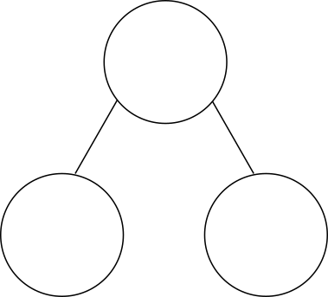
2AS-3 Add and subtract within 100 – part 1
Look at the first part-part-whole diagram. What addition equation can we write if we combine the cubes?
What’s the same and what’s different about the second part-part-whole diagram?
What do you notice about the total when we combine the cubes?
What’s the same about the ones digits in each calculation? What’s different about the totals? Can you explain why?
3 + 6 = 9
23 + 6 = 29
3 plus 6 is equal to 9, so I know that
23 plus 6 is equal to 29.

Slide 13
2AS-3 Add and subtract within 100 – part 1
+3
4 + 3 =
7
Look carefully at each number line. What can you say about the numbers at the start and end of each line?
Look at the calculations. What’s the same about each calculation? What’s different?
If you know that 4 plus 3 is equal to 7, can you predict what some of the totals will be without counting?
What do you notice about the totals? Can you explain why the ones digit has stayed the same? What do you notice about how the tens digit has changed? Can you explain why?
+3
14 + 3 =
17
+3
24 + 3 =
27
+3
34 + 3 =
37

Slide 14
2AS-3 Add and subtract within 100 – part 1
-3
Look carefully at each number line. What can you say about the numbers at the start and end of each line?
Look at the calculations. What’s the same about each calculation? What’s different?
If you know that 7 minus 3 is equal to 4, can you predict what the differences will be without counting?
What do you notice about the differences? Can you explain why the ones digit has stayed the same? What do you notice about how the tens digit has changed?
7 – 3 =
4
-3
17 – 3 =
14
-3
27 – 3 =
24
-3
37 – 3 =
34

Slide 15
2AS-3 Add and subtract within 100 – part 1
73
73
73
73
30
63
10
53
20
43
30
43
20
53
Watch the blocks as they partition and combine. What changes each time, the ones or the tens?
Using your own blocks and a part-part-whole diagram, can you partition and combine some numbers in the same way, making sure you keep the ones together? Can you record your partitions as a jotting?

Slide 16
2AS-3 Add and subtract within 100 – part 1
Let’s think about how knowing that 6 plus 2 is equal to 8 can help us find 60 + 25.
Look at the blocks. How many tens are in 60 and in 20? So what will the total number of tens be? What number is this?
So if we have 8 tens as part of the total, what will the ones digit be? Where can you see this in the blocks? And in the calculation?
So if we have 8 in the tens and 5 in the ones, the total of 60 and 25 must be…?
Repeat with other calculations where one number is a multiple of 10. Try some without the blocks.
6 + 2 = 8
60 + 25 = 85
?

Slide 17
2AS-3 Add and subtract within 100 – part 1
Look at the blocks. What number is represented? Can you see that number in the second expression?
How many tens are in 85 and in 60?
How could knowing that 8 minus 6 is equal to 2 help us with 85 minus 60? Does thinking about the number of tens help?
What do you notice about the ones digits in the minuend and difference?
8 – 6 = 2
85 – 60 = 25
If I know that 8 minus 6 is equal to 2,
I can use this to help find 85 minus 60.

Slide 18
2AS-3 Add and subtract within 100 – part 1
4 + 3 = 7
7 – 3 = 4
Read out the first pair of equations.
How does each new pair of equations relate to these?
Can you describe what’s the same and what’s different about each pair of additions and each pair of subtractions?
Can you write your own related equations for these pairs of numbers?
5 + 4 = 9 9 – 4 = 5
40 + 30 = 70
70 – 30 = 40
45 + 30 = 75
75 – 30 = 45
64 + 3 = 67
67 – 3 = 64

Slide 19
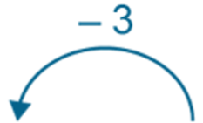
2AS-3 Add and subtract within 100 – part 1
How do you know 10 minus 3?
What’s the same and what’s different about the second calculation and number line?
How can knowing that 10 minus 3 is equal to 7 help us with 30 minus 3?
What do you notice is the same about 7 and 27? Why do you think this is the same?
0
7
10
10 – 3 = 7
0
10
20
27
30
30 – 3 = 27

Slide 20
2AS-3 Add and subtract within 100 – part 1
Complete these calculations without blocks or a number line, but use what you know about addition and subtraction of small numbers.
4 + 2 =
24 + 2 =
34 + 2 =
6 + 2 =
68 + 20 =
28 + 60 =
9 – 3 =
99 – 3 =
59 – 3 =
6 – 2 =
66 – 20 =
56 – 20 =

Slide 21
2AS-3 Add and subtract within 100 – part 1
Strike It Out
https://nrich.maths.org/6589

