Slide 1
2AS-2
Solve comparative addition and difference problems

Slide 2
2AS-2 Recognise the subtraction structure of ‘difference’ and answer questions of the form, “How many more…?”.
The materials in this pack have been collated and written to support the teaching of 2AS-2. Before planning and teaching the content, read the teaching guidance and example assessment questions in the non-statutory guidance itself, which can be found here.
A video summarising all of the ready-to-progress criteria for the year group can be found here.

Slide 3
2AS-2: Linked mastery PD materials
Additional pedagogical subject knowledge support can be found in the Mastery Professional Development Materials:
1.12 Subtraction as difference
Several of the activity slides have been taken from these materials.

Slide 4
2AS-2
Solve comparative addition and difference problems

Slide 5
The following slides contain activities that can be used within the context of pre-teaching, intervention, or as supplementary material integrated into teaching. They do not represent complete lessons and should not be used as such. Also they should not be used all at once, but over the period of a teaching unit. It would be valuable to use many of the activities more than once to build fluency in understanding and application. Also many of them would benefit from the use of manipulatives to support interaction with the ideas. Ensure you engage in rich discussion with the children, asking them to reason and explain the ideas presented. Note that when working with a small group, pupils should also have access to the main teaching delivered by the class teacher and the focus should be directly linked so that the learning is connected and fluency is built.

Slide 6
Guidance for working with a small pre-teaching or intervention group
Take time to build understanding of the key idea. We would recommend no more than four slides in any one session, and probably fewer.
In subsequent sessions, review and practise previous learning before moving on.
Play the animation/observe the image and ask pupils “What do you notice?”.
Encourage pupils to explain what they see, what is happening and why.
Where there is a highlighted sentence, draw out the meaning of this from the image and repeat together and individually.

Slide 7
Guidance for working with a small pre-teaching or intervention group
Engage in the suggested activities, using manipulatives where appropriate, to enhance the interaction and stimulate discussion. However, note that the ultimate aim is to develop fluency in the mathematical ideas such that resources are no longer needed.
Repeat questions, using other numbers/examples where relevant.
Repeat the highlighted language structures wherever relevant to build fluency with the key idea and connect the learning. For example:
10 hundreds are equivalent to 1,000.

Slide 8
2AS-2 Solve comparative addition and difference problems

Slide 9
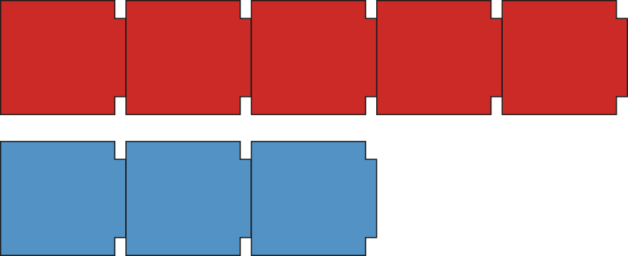
2AS-2 Solve comparative addition and difference problems
How could we arrange the cars to compare the numbers of each colour more easily?
Why is it easier to compare the numbers of cars when they are lined up?
Can you say whether there are more red cars or more blue cars? Which part of the diagram shows this?
What can you say about the number of blue cars compared to red cars?
How can we represent this with cubes?
2 cars
2
There are 2 more red cards than blue cars.
There are 2 fewer blue cars than red cars.

Slide 10
2AS-2 Solve comparative addition and difference problems
What words can we use when we are comparing the ages of the children?
Have you got a brother or sister who is younger or older than you? Maybe both!
In this picture, who is older? Who is younger?
How can we represent this with a bar model?
What do we call the number which shows how much younger or older each child is?
How can we use our number facts to help us find the difference between their ages?
Ben is 10 years old
Charlotte is 3 years old
10 years old
3 years old
difference of 7 years
Ben is 7 years older than Charlotte.
Charlotte is 7 years younger than Ben.
3 + ___ = 10
7

Slide 11
2AS-2 Solve comparative addition and difference problems
What do you notice about the number of children and the number of pencils?
Can you say whether there are more or fewer pencils than children?
How can we find out how many more children than pencils there are?
How does the missing number equation help you find the difference?
How does the subtraction help you find the difference?
8
3
5
5
3 + ___ = 8
8 – 3 = 5
We can use subtraction to find the difference and solve questions about ‘how many more’ or ‘how many fewer’?

Slide 12
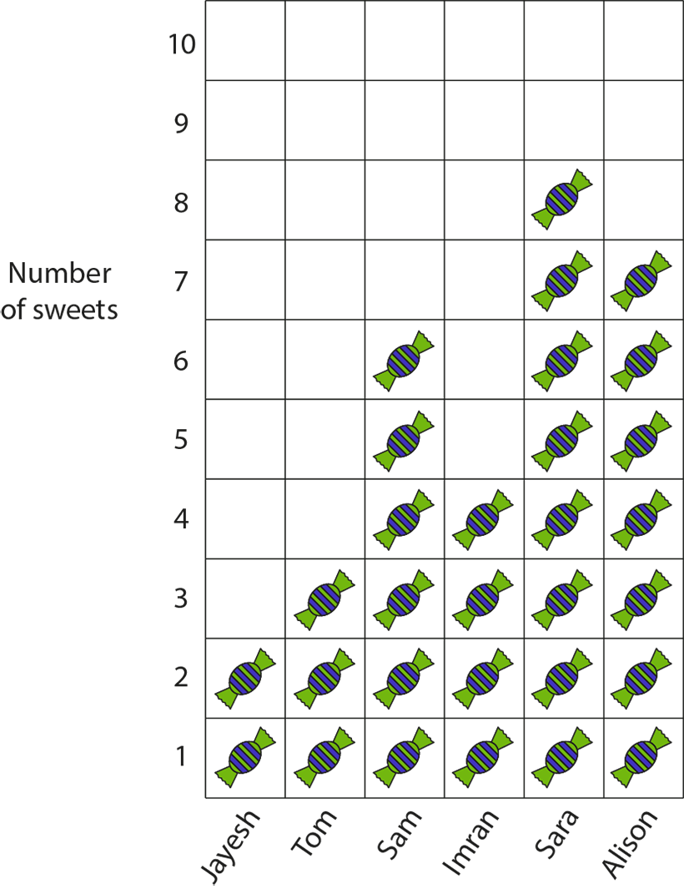
2AS-2 Solve comparative addition and difference problems
What do you think the pictogram shows us?
Can you choose the correct words (more or fewer) to complete these sentences?
Jayesh has ___ sweets than Tom.
Tom has ___ sweets than Jayesh.
Can you make up some similar sentences?
Can you use subtraction to find the difference between the number of sweets pairs of children have?

Slide 13
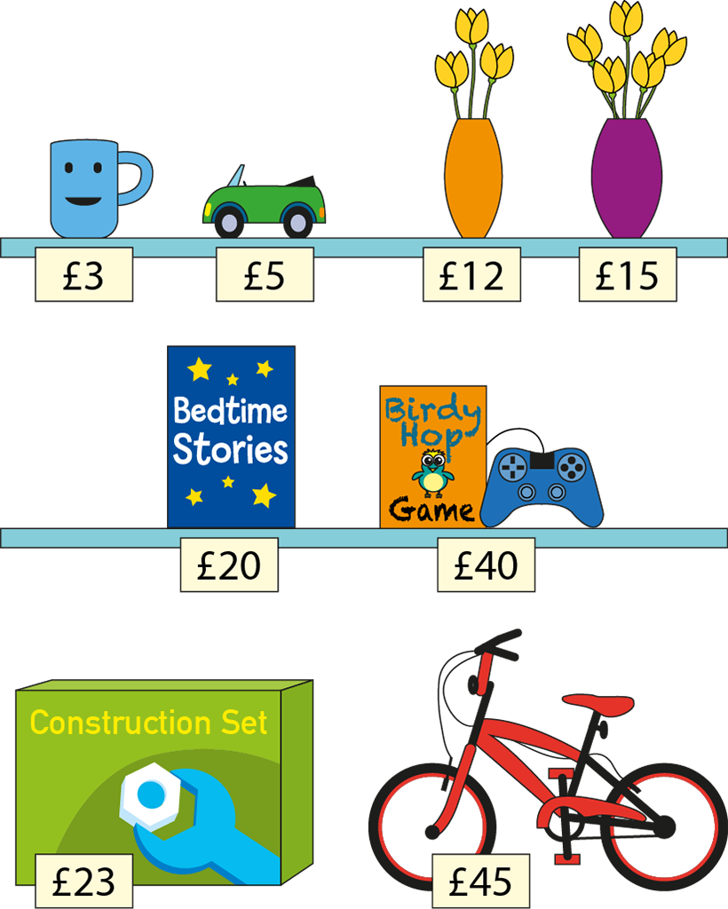
2AS-2 Solve comparative addition and difference problems
I have £20 to spend at the shop.
How much more money do I need to be able to buy the Birdy Hop Game?
What about the Construction Set?
Think of your own questions using the words ‘how much more money do I need to buy the …?’ Solve your questions using subtraction.
What if I only had £10? What questions could you ask?

Slide 14
2AS-2 Solve comparative addition and difference problems
10 + = 16 16 – 10 = ___
Look at the bar model. What pair of numbers is it showing the difference between? What is the difference between these numbers? How do you know?
How does the number line show this difference?
What calculations could we write to represent the difference between this pair of numbers?
What is the same and what is different about the calculations?
16
10
6
6
0
1
2
3
4
5
6
7
8
9
10
11
12
13
14
15
16

Slide 15
2AS-2 Solve comparative addition and difference problems
Sketch a bar model and find the difference between these pairs of numbers using subtraction.
7 and 4
6 and 9
5 and 8
17 and 14
16 and 19
15 and 18
£42 and £40
£25 and £35
£40 and £10
9p and 15p
15p and 9p
26p and 29p

