Slide 1
2AS-1
Add and subtract across 10

Slide 2
2AS-1 Add and subtract across 10, for example: 8 + 5 = 13 13 – 5 = 8
The materials in this pack have been collated and written to support the teaching of 2AS-1. Before planning and teaching the content, read the teaching guidance and example assessment questions in the non-statutory guidance itself, which can be found here.
A video summarising all of the ready-to-progress criteria for the year group can be found here.

Slide 3
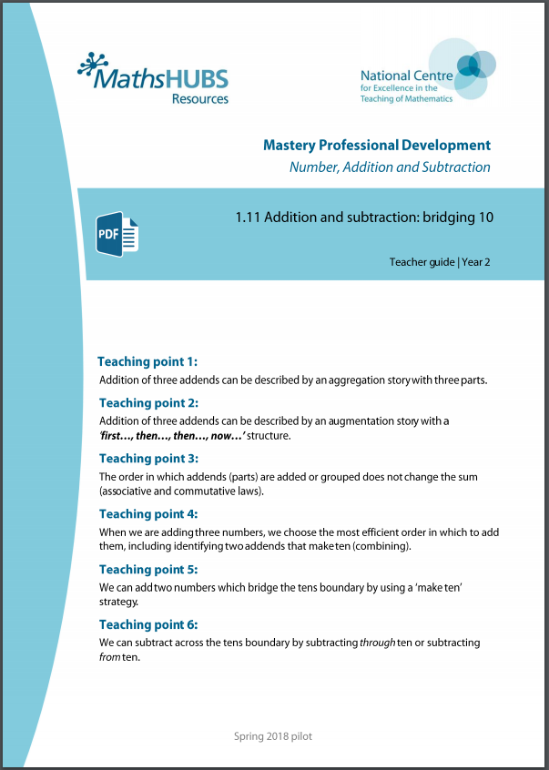
2AS-1: Linked mastery PD materials
Additional pedagogical subject knowledge support can be found in the Mastery Professional Development Materials:
1.11 Addition and subtraction: bridging 10
Several of the activity slides have been taken from these materials.

Slide 4
2AS-1
Add and subtract across 10

Slide 5
The following slides contain activities that can be used within the context of pre-teaching, intervention, or as supplementary material integrated into teaching. They do not represent complete lessons and should not be used as such. Also they should not be used all at once, but over the period of a teaching unit. It would be valuable to use many of the activities more than once to build fluency in understanding and application. Also many of them would benefit from the use of manipulatives to support interaction with the ideas. Ensure you engage in rich discussion with the children, asking them to reason and explain the ideas presented. Note that when working with a small group, pupils should also have access to the main teaching delivered by the class teacher and the focus should be directly linked so that the learning is connected and fluency is built.

Slide 6
Guidance for working with a small pre-teaching or intervention group
Take time to build understanding of the key idea. We would recommend no more than four slides in any one session, and probably fewer.
In subsequent sessions, review and practise previous learning before moving on.
Play the animation/observe the image and ask pupils “What do you notice?”.
Encourage pupils to explain what they see, what is happening and why.
Where there is a highlighted sentence, draw out the meaning of this from the image and repeat together and individually.

Slide 7
Guidance for working with a small pre-teaching or intervention group
Engage in the suggested activities, using manipulatives where appropriate, to enhance the interaction and stimulate discussion. However, note that the ultimate aim is to develop fluency in the mathematical ideas such that resources are no longer needed.
Repeat questions, using other numbers/examples where relevant.
Repeat the highlighted language structures wherever relevant to build fluency with the key idea and connect the learning. For example:
10 hundreds are equivalent to 1,000.

Slide 8
2AS-1 Add and subtract across 10

Slide 9
2AS-1 Add and subtract across 10
7 + 5
= 7 + 3 + 2
= 10 + 2
Look at the picture and the expression. How many red counters are being added to the blue counters?
How many red counters need to go on the first ten frame to fill it up and make ten?
Now we have 10 counters and 2 counters on the ten frames, how many counters are there altogether?
How did we partition the 5 to add it to 7? Why did we do it that way? Try this on your own ten frames.
We can use a making ten strategy to add past ten.

Slide 10
2AS-1 Add and subtract across 10
Try these calculations using two ten frames and different coloured counters.
For each calculation, talk about how we can make ten and how we will have to partition the second number.
As children become more confident, they can record each part of the calculation as they move the counters, and talk about how it represents what is on the ten frames.
Check that children are using known bonds of ten to partition numbers, and place value knowledge to add a single digit to ten, rather than counting.
7 + 6
7 + 8
7 + 5
8 + 5
9 + 5

Slide 11
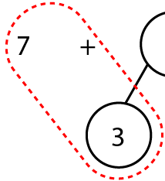
2AS-1 Add and subtract across 10
7
+
5
Let’s look at 7 + 5 using a part-part-whole diagram.
Why has the 5 been partitioned into 3 and 2?
Let’s add the 7 and 3 first. What does 7 + 3 total?
Now add the 2. Why is it easy to add a single digit number to ten without counting?
3
2
7 + 3
= 10
10 + 2
= 12

Slide 12
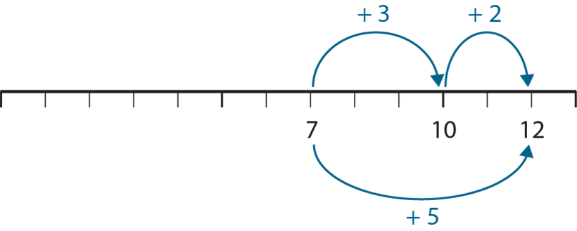
2AS-1 Add and subtract across 10
Let’s see what 7 + 5 looks like on a number line.
Why do we need to start our jumps from 7? Why is the first a jump of 3?
Did we need to jump forwards or backwards? Why?
What is the next jump to complete the calculation 7 + 5? How do you know?
What will the total be if we make a jump of 2 from 10? So 7 + 5 is equal to…?

Slide 13
2AS-1 Add and subtract across 10
The following slides demonstrate two different methods for subtraction.
Method 1 is to subtract back through the 10.
Method 2 is to subtract from the 10 and then add what is remaining.
As this is a review session you may just to focus on the method that the child is most familiar with, probably method 1. However, if you feel they are ready, you may wish to introduce method 2. Children sometimes find this easier when they are familiar with it as all of the subtrahend is subtracted from 10, which uses their number bonds to 10 knowledge. Encourage them to use the number bonds they know rather than count back in ones.
The nine is partitioned into 5 and 4.
Take away 5 is 10.
Take away 4 from 10 is 6.
The answer is 6
Method 1
The 15 is partitioned into 10 and 5.
Take away 9 from the 10, this leaves 1.
Put 1 and 5 together.
The answer is 6.
Method 2

Slide 14
2AS-1 Add and subtract across 10
Let’s think about 15 − 9. What is the minuend? (15) What is the subtrahend? (9)
How can we partition the 9 (the subtrahend) to make the calculation easier?
Why has 9 been partitioned into 5 and 4?
Let’s start with 15 − 5. How can we think about that without counting?
Now what do we need to subtract?
How can we think about 10 − 4 without counting?
So, what is 15 − 9?
15 – 9
5
4
15 – 9 =
6
We can partition the subtrahend to help us subtract.
We can use a subtracting through 10 strategy.

Slide 15
2AS-1 Add and subtract across 10
− 9
− 4
− 5
6
10
15
Let’s look what 15 − 9 looks like with a bead string using this method. What do you notice about the 15 beads?
Why is subtracting 5 beads easy to start with?
What would we need to subtract after subtracting 5 beads?
How can we think about subtracting 4 from 10 without needing to count?

Slide 16
2AS-1 Add and subtract across 10
Let’s see what 15 − 9 looks like on the number line. Where do we need to start from?
Which way will we make the jumps if we are subtracting?
What number is it easy to jump to without needing to count
What do you think is our next jump? How do you know?
If we make a jump of 4 from 10, what will we land on?
Can you remind me how we chose what each jump should be?

Slide 17
2AS-1 Add and subtract across 10
Let’s look at a different strategy for 15 − 9. Can you tell me a way that we could partition the minuend (15)?
If we partition the minuend into 10 and 5, how can we subtract 9 easily, without needing to count?
15 – 9
10
5
Can you see where we can subtract 9 counters? What will be left?
Can you remind me whether we partitioned the minuend (15) or the subtrahend (9)? Why did we partition it in the way we did? Now you try 15 − 8 using a ten frame to help you.
15 – 9 = 6

Slide 18
2AS-1 Add and subtract across 10
Method 1
Subtracting through 10
Method 2
Subtracting from 10
Let’s compare the methods.
Which number was partitioned in each method - the minuend or the subtrahend?
Can you explain how partitioning 9 into 5 and 4 helped us?
Can you explain how partitioning 15 into 10 and 5 helped us?
Which strategy do you prefer?
15 – 9

Slide 19
2AS-1 Add and subtract across 10
Now repeat the 2 methods for 15 – 9.
Use the words in the boxes as you move the counters.
Work with a partner and aske them to write the equations as you move the counters :
Method 1 Method 2
Now practise with other numbers using your tens frames and the words in the boxes and write the equations.
14 – 6 12 – 5
13 – 7 17 – 9
Can you do these calculations without using
the tens frames?
Method 1
The nine is partitioned into 5 and 4.
Take away 5 is 10.
Take away 4 from 10 is 6.
The answer is 6.
15
− 5
= 10
10 – 9 = 1
10
− 4
= 6
1 + 5 = 6
15
− 9
= 6
15
− 9
= 6
Method 2
The 15 is partitioned into 10 and 5.
Take away 9 from the 10, this leaves 1.
Put 1 and 5 together.
The answer is 6

