Slide 1
1NPV-1
Count forwards and backwards within 100

Slide 2
1NPV-1 Count within 100, forwards and backwards, starting with any number.
The materials in this pack have been collated and written to support the teaching of 1NPV-1. Before planning and teaching the content in 1NPV-1, read the teaching guidance and example assessment questions in the non-statutory guidance itself, which can be found here.
A video summarising all of the ready-to-progress criteria for Year 1 can be found here.

Slide 3
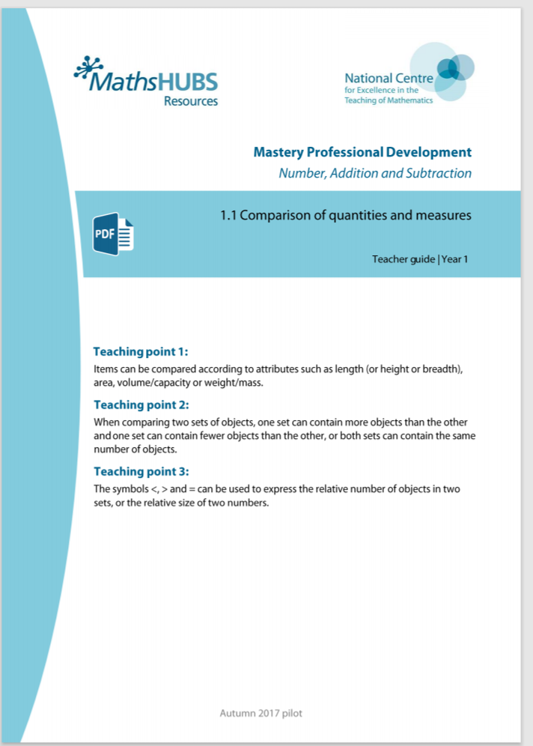
1NPV-1: Linked mastery PD materials
Additional pedagogical subject knowledge support can be found in the Mastery Professional Development Materials:
1.1 Comparison of quantities and measures
Several of the activity slides have been taken from these materials.

Slide 4
1NPV-1
Count forwards and backwards within 100

Slide 5
The following slides contain activities that can be used within the context of pre-teaching, intervention, or as supplementary material integrated into teaching. They do not represent complete lessons and should not be used as such. Also they should not be used all at once, but over the period of a teaching unit. It would be valuable to use many of the activities more than once to build fluency in understanding and application. Also many of them would benefit from the use of manipulatives to support interaction with the ideas. Ensure you engage in rich discussion with the children, asking them to reason and explain the ideas presented. Note that when working with a small group, pupils should also have access to the main teaching delivered by the class teacher and the focus should be directly linked so that the learning is connected and fluency is built.

Slide 6
Guidance for working with a small pre-teaching or intervention group
Take time to build understanding of the key idea. We would recommend no more than four slides in any one session, and probably fewer.
In subsequent sessions, review and practise previous learning before moving on.
Play the animation/observe the image and ask pupils “What do you notice?”.
Encourage pupils to explain what they see, what is happening and why.
Where there is a highlighted sentence, draw out the meaning of this from the image and repeat together and individually.

Slide 7
Guidance for working with a small pre-teaching or intervention group
Engage in the suggested activities, using manipulatives where appropriate, to enhance the interaction and stimulate discussion. However, note that the ultimate aim is to develop fluency in the mathematical ideas such that resources are no longer needed.
Repeat questions, using other numbers/examples where relevant.
Repeat the highlighted language structures wherever relevant to build fluency with the key idea and connect the learning. For example:
10 hundreds are equivalent to 1,000.

Slide 8
1NPV-1 Count forwards and backwards within 100

Slide 9
1NPV-1 Count forwards and backwards within 100
Can you count in ones between 1 and 100, both forwards and backwards?
Can you start your count from different numbers?
Can you say the number of straws each time a bundle is tied up? Louder!
Are you saying the ‘teen numbers’ clearly?
Can you say the count in two ways?
x
Begin by using real straws to count and bundle together in groups of 10.
Seven, eight, nine, ten, eleven, twelve… twenty, twenty-one, twenty-two…
Seven, eight, nine, ten, one-ten, one-ten-one, one-ten-two… two-tens, two-tens-one, two-tens-two…

Slide 10
1NPV-1 Count forwards and backwards within 100
1
2
3
4
5
6
7
8
9
10
Can you count forwards and backwards between 1 and 100, starting in different places on the 100 square?
Can you say the ‘teen’ part of these numbers a little louder? Thirteen, fourteen, fifteen…
Can you say the numbers which come after these numbers: 19…, 29…, 39…, 99…? Say them loudly and clearly: twenty, thirty, forty…
Can you say the numbers which come before these numbers: 30, 50, 70, 100?
Where on the 100 square can you see the counting numbers which come before 21, 31, 41…?
11
12
13
14
15
16
17
18
19
20
21
22
23
24
25
26
27
28
29
30
31
32
33
34
35
36
37
38
39
40
41
42
42
44
45
46
47
48
49
50
51
52
53
54
55
56
57
58
59
60
61
62
63
64
65
66
67
68
69
70
71
72
73
74
75
76
77
78
79
80
81
82
83
84
85
86
87
88
89
90
91
92
93
94
95
96
97
98
99
100

Slide 11
1NPV-1 Count forwards and backwards within 100
Can you join in saying the numbers in the count?
Are you saying these numbers very clearly: 14/ 40, 15/50, 16/60 etc?
Watch the ‘ones digit’ as it changes - what do you notice?
Now watch the ‘tens digit’ - what do you notice?
Pause at some numbers and think about what comes next.
Can you count backwards, especially from these numbers: 20, 30, 40, 50, 60…?
100
21
31
41
51
61
71
81
91
12
22
32
42
52
62
72
82
92
13
23
33
42
53
63
73
83
93
14
24
34
44
54
64
74
84
94
15
25
35
45
55
65
75
85
95
16
26
36
46
56
66
76
86
96
17
27
37
47
57
67
77
87
97
18
28
38
48
58
68
78
88
98
19
29
39
49
59
69
79
89
99
10
20
30
40
50
60
70
80
90
11
1
2
3
4
5
6
7
8
9

Slide 12
1NPV-1 Count forwards and backwards within 100
0
10
20
30
40
50
60
70
80
90
100
Can you read the numbers shown on the number line between zero and one hundred?
What do you notice about these numbers?
Can you join in with the count as the arrow moves along the line? Say the numbers shown on the number line a little louder!
Move the arrow to different places on the number line - can you work out the number which the arrow has stopped at by counting on or back from the numbers shown on the line? Use a large class number line if possible where children can touch a point and identify the number.

Slide 13
1NPV-1 Count forwards and backwards within 100
What do you notice about the numbers written below the number line?
What do you notice about these numbers written above the number line?
Why might it be tricky to remember what comes before these numbers: 20, 30, 40, 50 etc?

Slide 14
1NPV-1 Count forwards and backwards within 100
Before we count, can you say the numbers which come before the numbers shown on the number line?
Starting from 100, can you join in with the count? Are we counting forwards or backwards?
Pause at the numbers shown. Can you remember what number we will say next?

Slide 15
1NPV-1 Count forwards and backwards within 100
1,000
2,000
3,000
4,000
5,000
6,000
7,000
8,000
9,000
100
200
300
400
500
600
700
800
900
10
20
30
40
50
60
70
80
90
1
2
3
4
5
6
7
8
9
Let’s use the chart to tap out the numbers in our count between one and one hundred! Remember to get the order right, for the teen numbers tap the ten first and then the ones.
Let’s start at 20… we can tap 20 and 1 for twenty-one, 20 and 2 for twenty-two… How can I tap twenty-three? What do we tap after twenty-nine?
How can we tap out the teen numbers? Do we say ‘tenty-one, tenty-two’? What do you notice about how we say the number fourteen when I tap the chart?

