Slide 1
1G-2
Compose 2D and 3D shapes from smaller shapes

Slide 2
1G-2 Compose 2D and 3D shapes from smaller shapes to match an example, including manipulating shapes to place them in particular orientations.
The materials in this pack have been collated and written to support the teaching of 1G-2. Before planning and teaching the content, read the teaching guidance and example assessment questions in the non-statutory guidance itself, which can be found here.
A video summarising all of the ready-to-progress criteria for Year 1 can be found here.

Slide 3
1G-2
Compose 2D and 3D shapes from smaller shapes

Slide 4
The following slides contain activities that can be used within the context of pre-teaching, intervention, or as supplementary material integrated into teaching. They do not represent complete lessons and should not be used as such. Also they should not be used all at once, but over the period of a teaching unit. It would be valuable to use many of the activities more than once to build fluency in understanding and application. Also many of them would benefit from the use of manipulatives to support interaction with the ideas. Ensure you engage in rich discussion with the children, asking them to reason and explain the ideas presented. Note that when working with a small group, pupils should also have access to the main teaching delivered by the class teacher and the focus should be directly linked so that the learning is connected and fluency is built.

Slide 5
Guidance for working with a small pre-teaching or intervention group
Take time to build understanding of the key idea. We would recommend no more than four slides in any one session, and probably fewer.
In subsequent sessions, review and practise previous learning before moving on.
Play the animation/observe the image and ask pupils “What do you notice?”.
Encourage pupils to explain what they see, what is happening and why.
Where there is a highlighted sentence, draw out the meaning of this from the image and repeat together and individually.

Slide 6
Guidance for working with a small pre-teaching or intervention group
Engage in the suggested activities, using manipulatives where appropriate, to enhance the interaction and stimulate discussion. However, note that the ultimate aim is to develop fluency in the mathematical ideas such that resources are no longer needed.
Repeat questions, using other numbers/examples where relevant.
Repeat the highlighted language structures wherever relevant to build fluency with the key idea and connect the learning. For example:
10 hundreds are equivalent to 1,000.

Slide 7
1G-2 Compose 2D and 3D shapes from smaller shapes

Slide 8
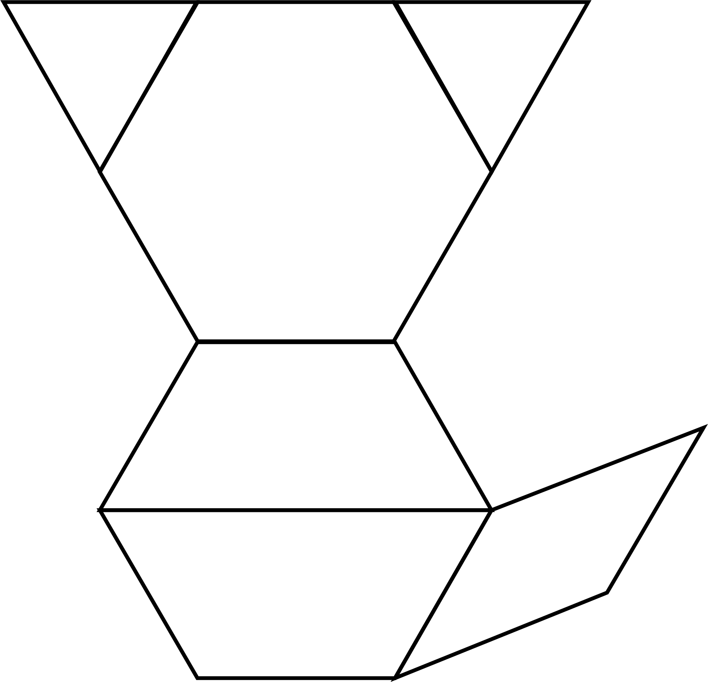
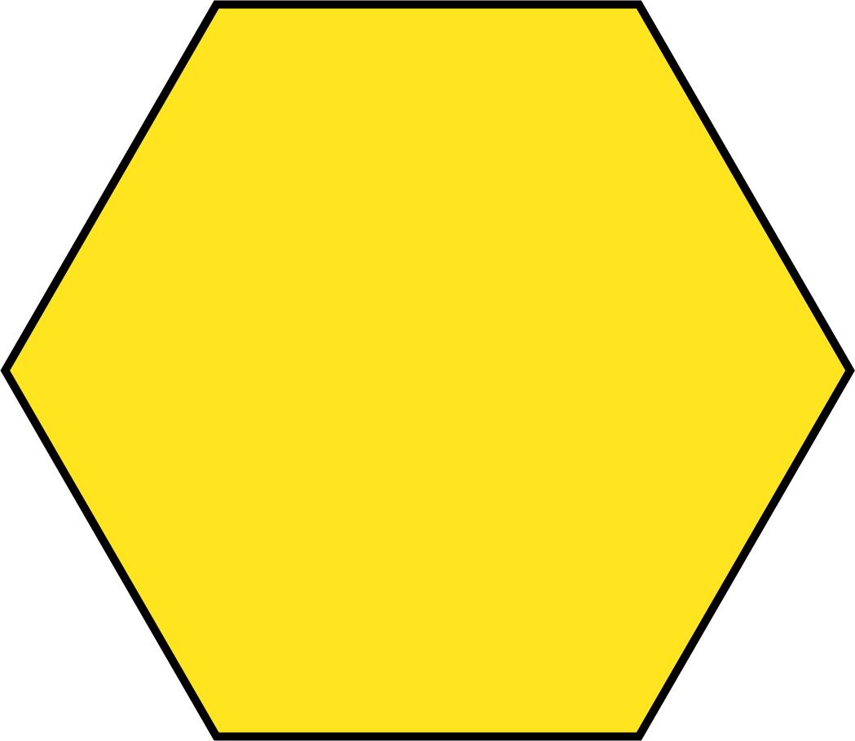
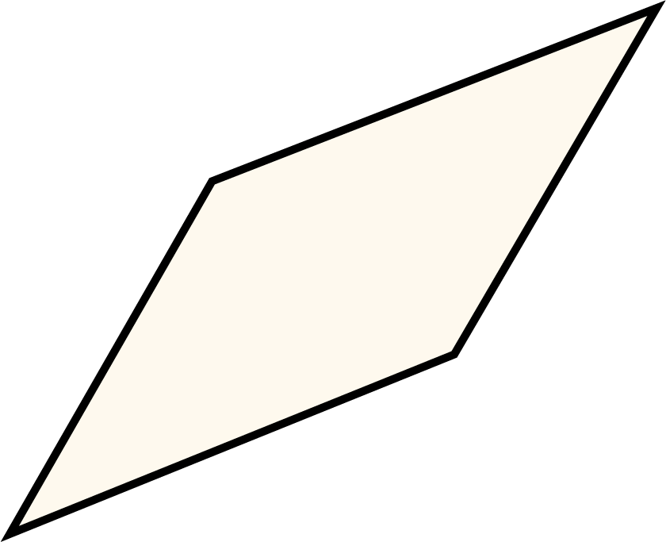
1G-2 Compose 2D and 3D shapes from smaller shapes
Can you find your own pattern blocks the same as these? Can you name any of the shapes you need?
Can you make the picture shown here? Lay the blocks over a copy of the image.
Which of these shapes will need to be rotated to fit on this picture?
Can you say where each piece should be placed?
What do you notice about the two red shapes and the yellow shape?

Slide 9
1G-2 Compose 2D and 3D shapes from smaller shapes
Can you make the same picture using these shapes? What did you need to do to make the same picture?
What other pictures can you make with these pattern blocks?
What other pictures can you make using some different pattern blocks?
Can you copy a pattern your friend has made?

Slide 10
1G-2 Compose 2D and 3D shapes from smaller shapes
What do you notice about the pieces in the tangram? Do any of the shapes have the same name? In what way are some of the triangles different to each other?
Can you make a picture with your tangram and describe it to your friend?
Can you use your own tangram pieces to make this picture?
There are five triangles in the tangram. Some of them are exactly the same shape and size.

Slide 11
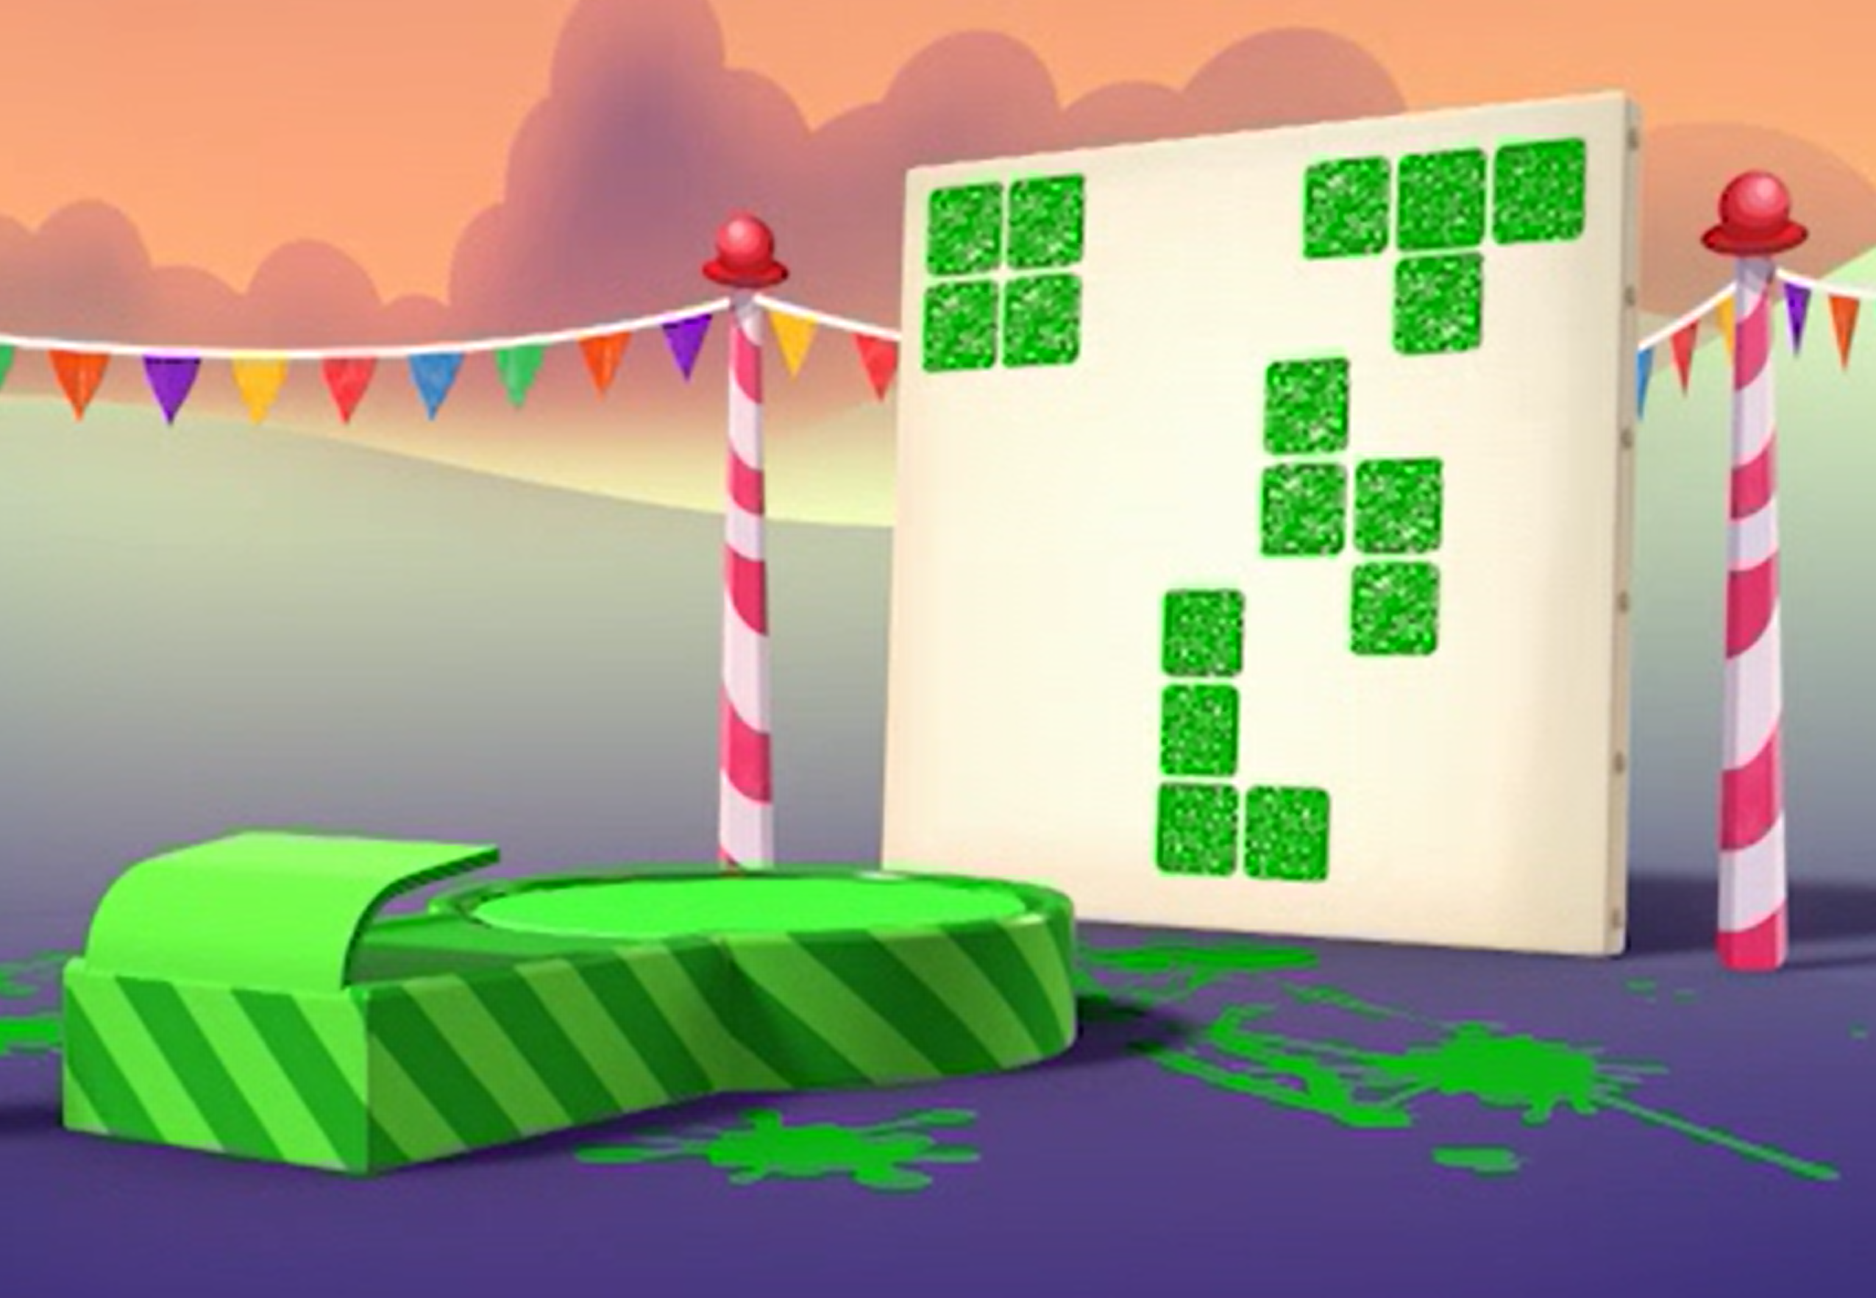
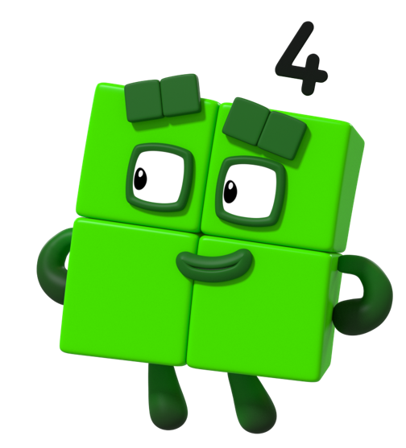
1G-2 Compose 2D and 3D shapes from smaller shapes
What do you notice about these different shapes. They were made by a Numberblock, can you guess which one?
Will the other Numberblocks make the same or different shapes?
Can you use your own cubes and paint to make some Numberblock prints?
Can you guess which Numberblock your friend used to make their picture?
Images © 2017 Alphablocks Ltd. All Rights Reserved.

Slide 12
1G-2 Compose 2D and 3D shapes from smaller shapes
Can you pick up the same number of cubes as I have here?
What shapes can you make? Can you describe them to your friend?
Did you make any of these shapes?
Do they look different if you turn them around?
Can you make the same shapes as mine? What do these shapes look like when they stand up or lie down?

Slide 13
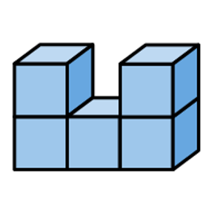
1G-2 Compose 2D and 3D shapes from smaller shapes
Pick up or make this shape
Can you change it to make it look like the shape below.
Describe what to do to make it look like the shape below and then build it.
a
To change shape a to shape b I must take off one of the bricks on top and join it to the bottom row.
b

Slide 14
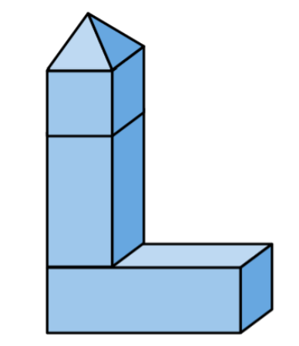
1G-2 Compose 2D and 3D shapes from smaller shapes
Can you choose your own shapes to use to make your own building?
Can you describe the building I have made here? Can you find the same shapes I used to make it and copy it?
Can you find and name some shapes which are the best ones for making a tall building? Which ones are not so good? Why?

